Slide 1

School Management System
Dha Lhamu Lama
NCC ID: 00171890

Slide 2
Introduction
School management system is a software that handles the activities of the school.
Built with the use of PHP language with its framework called Laravel and Sympony.
Backend design with Laravel and Sympony
Frontend built with the bootstrap with its framework like html, css, javascript
Database is done with use of mysql to store the details of school
Xampp is installed and used for the system since it is necessary to open the website

Slide 3
Problem statement
School without this software is having big problem in managing the daily details of school activities. Problems were
Difficult to understand how to manage the students
Problem in finding the details of anything of school whenever needed
Problem in communication with teacher

Slide 4
Background of project
The school management has no record system in database, they are using record book for all the activities which is waste of money and also not safe since it can be damaged by air, water and dust.
Difficult in finding the record of students and the teachers.
Time consuming since searching each student in the record book is difficult.
School was facing the problem in recording the attendances and the report in and fees
There was not clear idea of how many students are enrolled every year.

Slide 5
Aims and Objectives
Aims
To meet the requirements of the school
To analyze the details data of school that includes teacher, student, class etc.
To make admin easy in running academic process easy and fast
To provide online exams
To provide SMS/email facility for the notifications by admin

Slide 6
Objectives
(a) Record keeping
It maintains the data of all the student and teacher in database system.
It maintains the personal record as well as the academic record of the student.
It maintains student fee record and dues record.
Teacher personal record and salary record are also store in the software.
It also manages class record, subject record, examination record.

Slide 7
(b) Reports Generating
Reports are the essential outcomes of school management system (SMS).Reports includes the given points
Total number of student in the class
Student admission reports
Character certificate of the student
Submitted due reports
Teacher Experience reports
Examination report
Detail Marks Certificate

Slide 8
Features
Following are the main features of our project
Admin work
Crud function
Thorough Attendance
Maintaining Examination
Communication

Slide 9
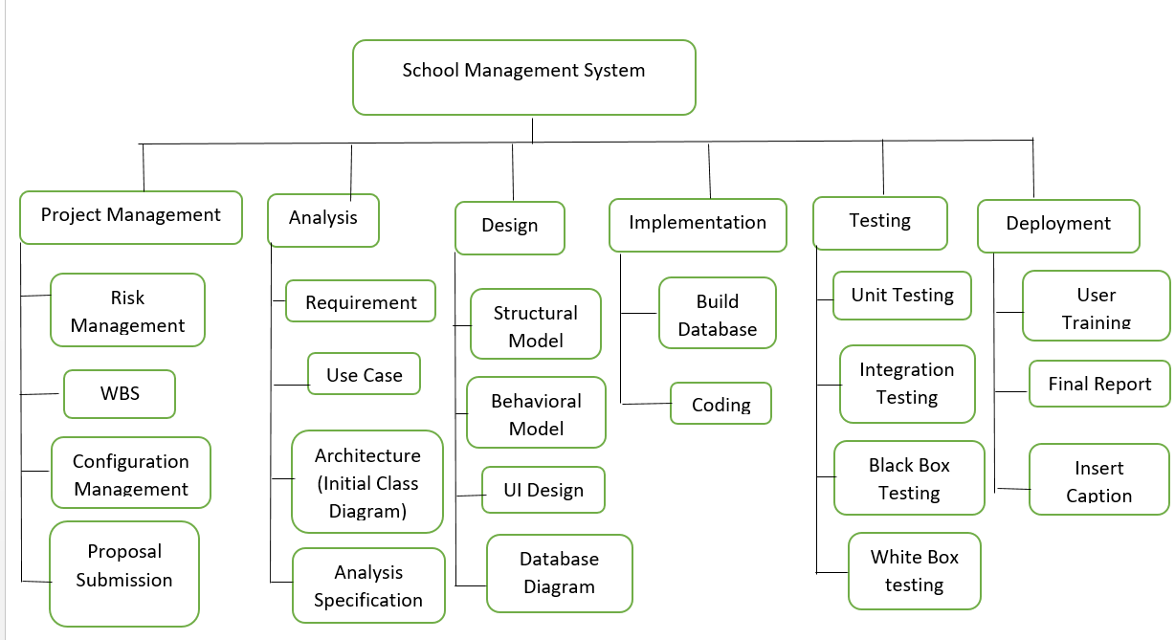
Work Breakdown system Work breakdown structure is a project management and systems where works are divided into smaller projects.

Slide 10
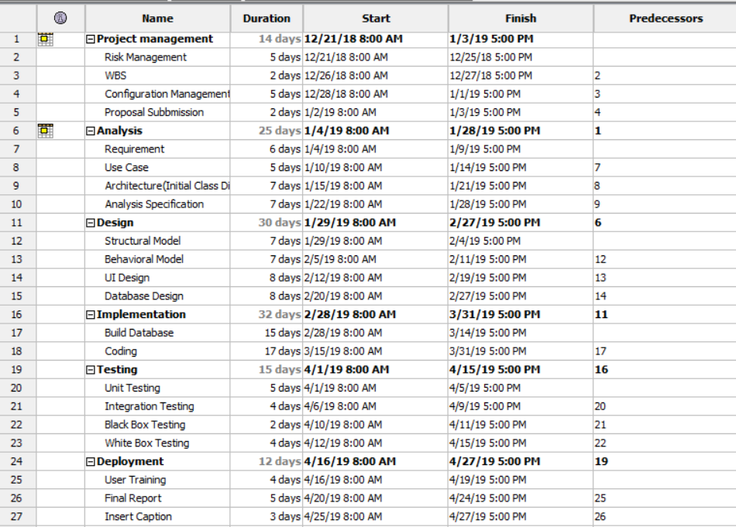

Slide 11
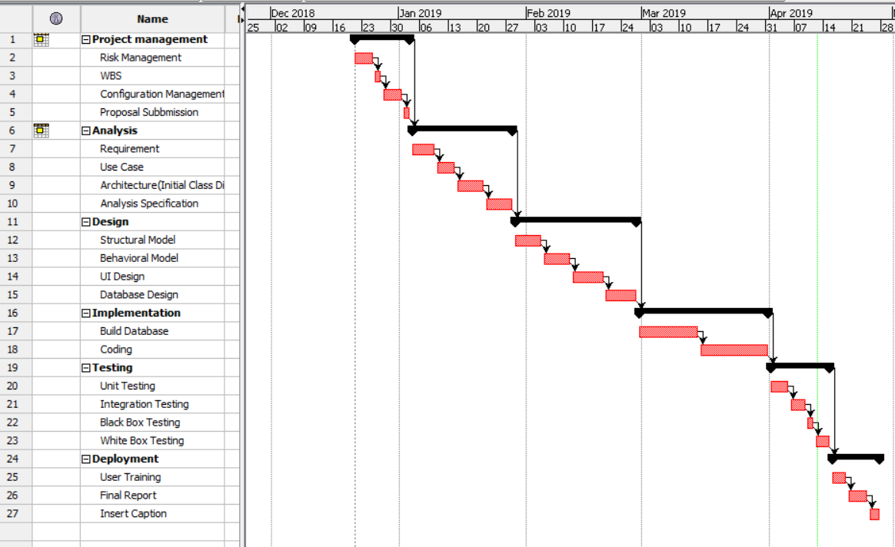
Gantt Chart

Slide 12
Methodology
Waterfall methodology is used
All the project process is done with the steps of waterfall method lik
Requirement gathering
Design
Implementation
verification
Maintenance

Slide 13
Architecture
3-tier system architecture is used
Presentation Layer
Logic Tier
Data Tier

Slide 14
Risk management
Risk Management is the process of identifying, evaluating, and the prioritizing of the risks seen in the management. Risk can be controlled by the given points below
Identify the reason of risks
Understand who gets harmed and how
Follow the steps of evaluating the risks and follow precautions measures
review the project risks and update if needed

Slide 15
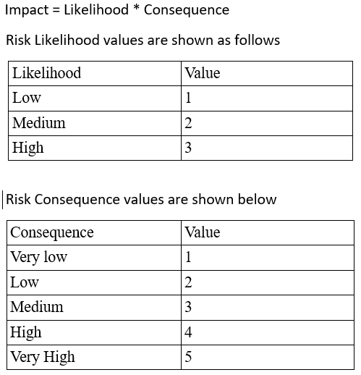

Slide 16
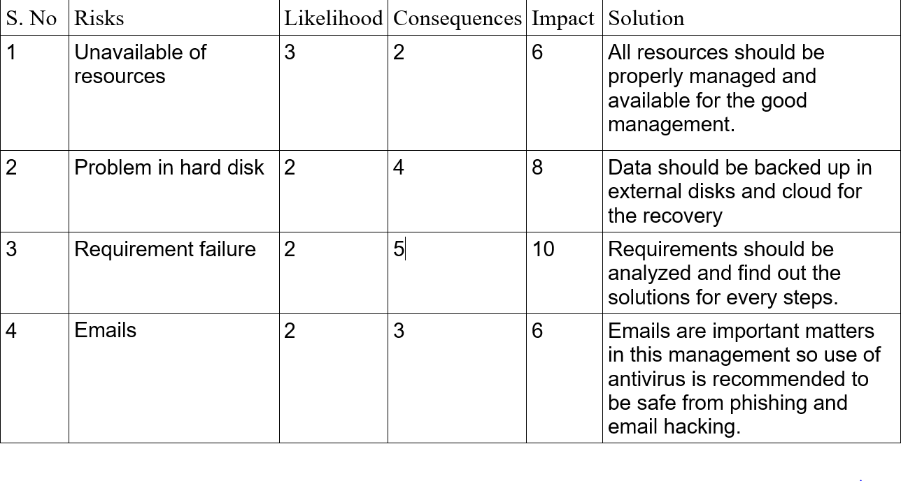
Risk are evaluated on the basis of following table

Slide 17
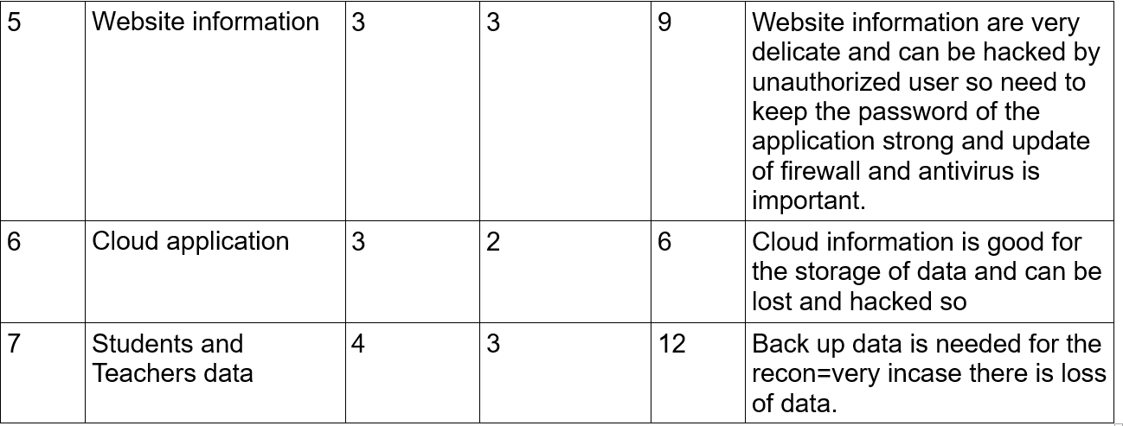

Slide 18
Design
Design is of two types
Structural and behavioural
Structural(usecase, er diagram)
Behavioural(activity, sequence)
School management system designed the given diagrams
Use case: A use case diagram is a graphic depiction of the interactions among the elements of a system.

Slide 19
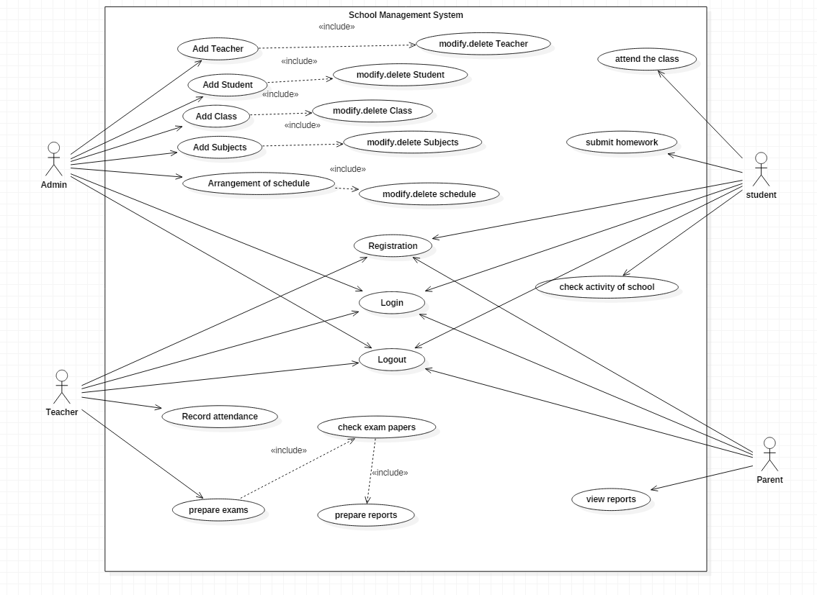
Use case for school management system

Slide 20
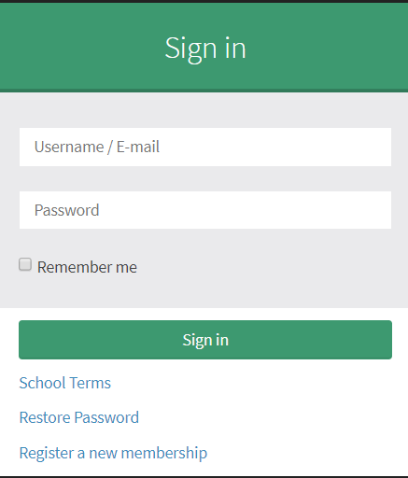
Coding and UI

Slide 21
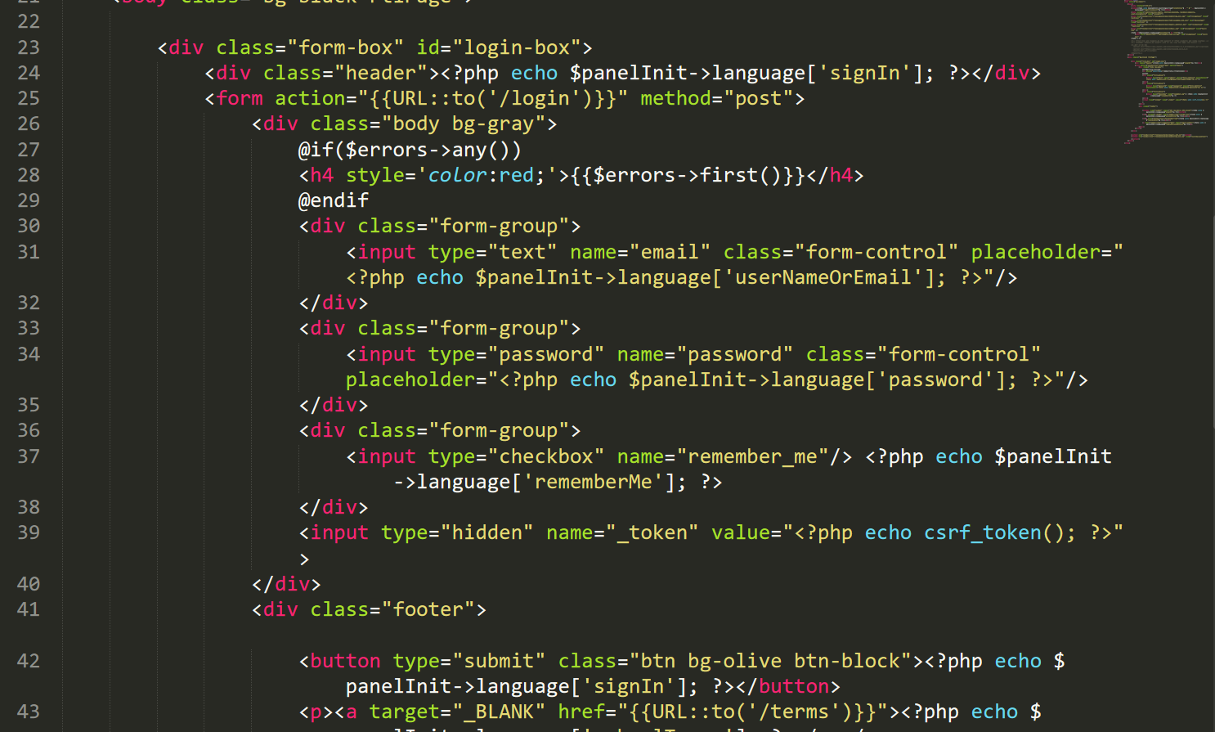

Slide 22
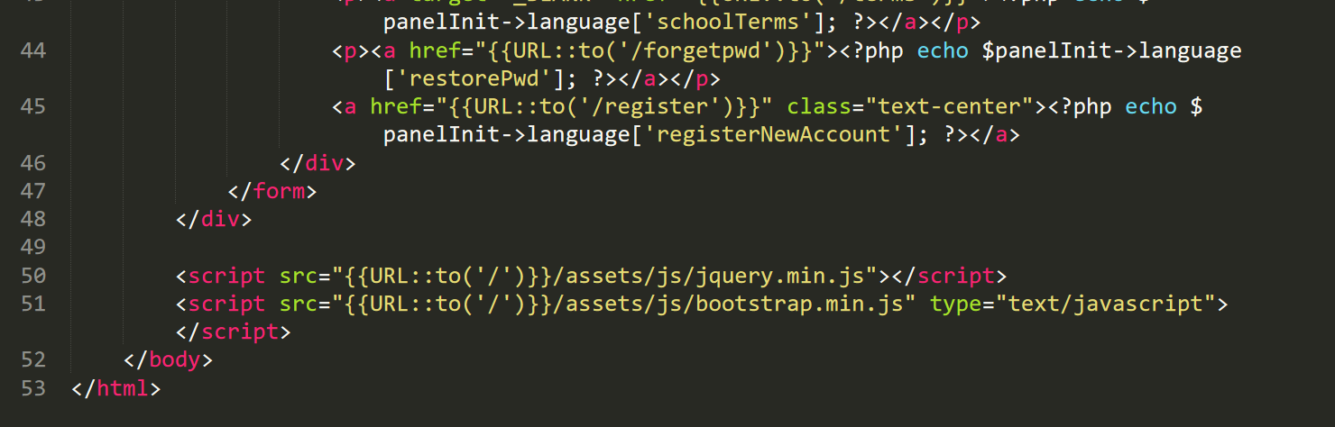

Slide 23
Test cases
I have tested the project in two ways. Black box testing and white box testing.
Black box testing is also known as behavioral testing that checks the internal part of the project but the tester wont understand
White box testing is also known as structural testing that checks the internal part of the project but the tester will understand.

Slide 24
Future work
Future work are as follows for my school management system
Online school management system is one of my future work
Student can pay through online their fees
Teacher can easily get paid through online.

Slide 25
User manual
User's main feature
All user can get registered and login in the page with the approval of the admin
User can view and send messages
User are notified about the events and holidays of he school
User can view the calendar and see the scheduling of the routine
Admin Main feature
Admin can register the students, teacher and parent
Admin can update and delete the information of students, teachers
Admin can assign the subject to the teacher for each class
Admin can notify the events and holidays of the school
Teacher's main feature
Teacher can give assignment to the students
Teacher can take the attendance of the students

Slide 26
User manual
Teacher can give exams and check the papers and prepare the results of the student
Student's main feature
Students can view their attendance
Students can view their homework assigned by the teacher
Students can see their results
For the user guidance following steps are to be followed to get access in this system

Slide 27
To get registered to the school, go to the button Register a new membership and then click and choose whether you are Teacher, Student or Parent then fill the all credentials given in the form. Parents need to have their child already registered to sign up the form.
Sign-up form for Teacher

Slide 28
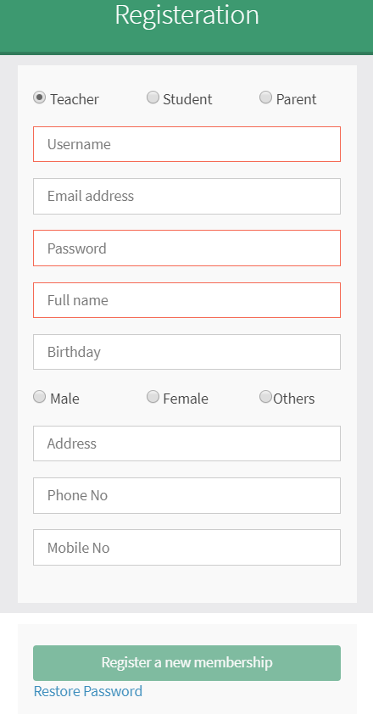
Teacher Register Form
Figure 43: Teacher Sign up Form

Slide 29
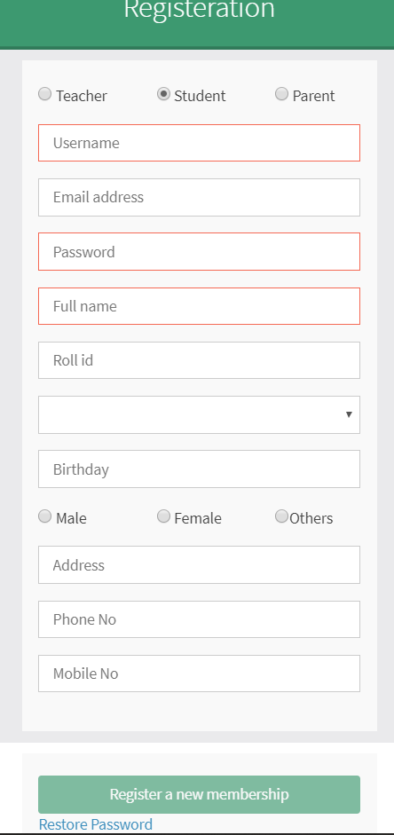
Student Registration Form
Student signup form

Slide 30
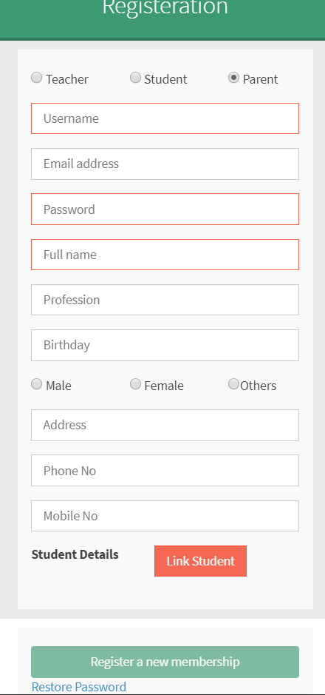
Parent Registration Form
Parent sign up form
dgbng
Figure 45: Parent sign up form

Slide 31
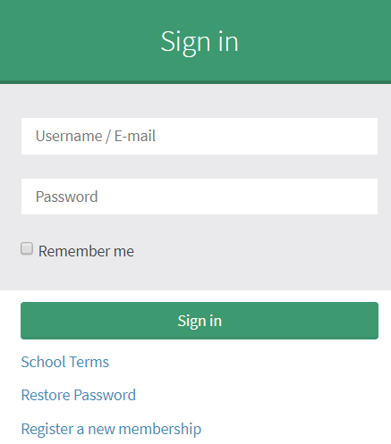
After successful registration approved by admin, users can login the page Login page for all users
Figure 46: Login form for users

Slide 32
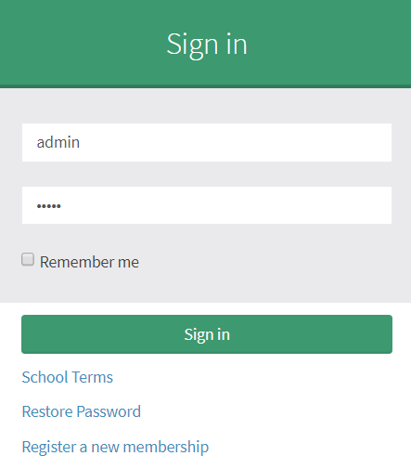
Steps for login
Put the username/E-mail id of the user and click to the button
Sign in which will lead you to the dashboard of the school
Let's see now how admin can modify the student details or name
Admin login with his/ her username and password
Figure 47: Admin Login form
After logging select the student icon

Slide 33
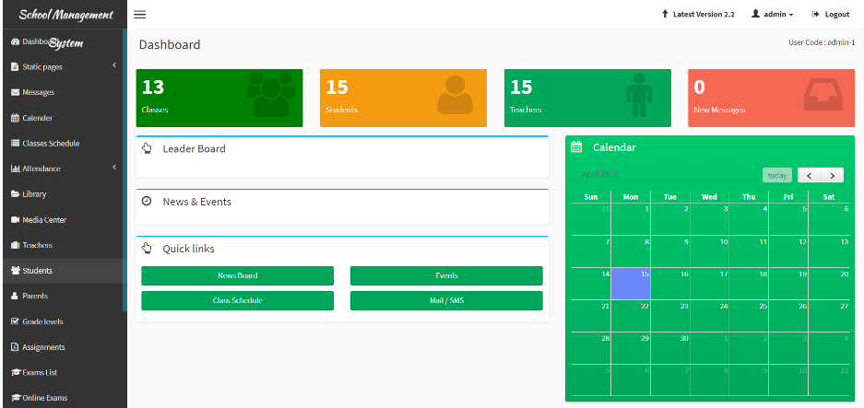
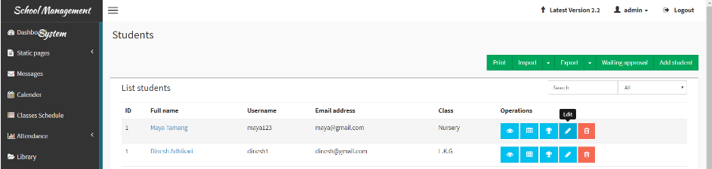
Then choose student to be modified
let's change the name of student named as Maya Tamang
Figure 48: Dashboard of Admin
Figure 49: student name before changing

Slide 34
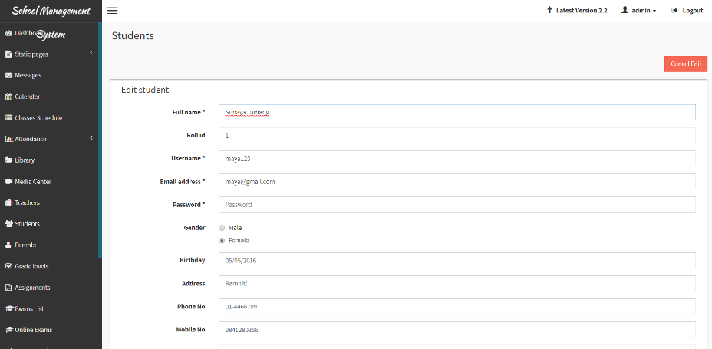

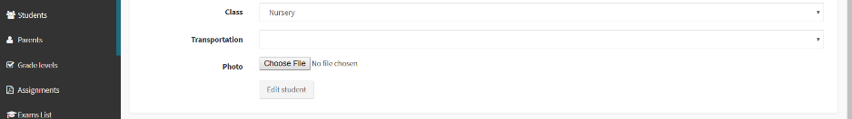
Then change the name and click to button Edit student
After edition of the student, there comes a message box which is displayed below
Figure : Student name modified successfully
Figure: Student name renamed

Slide 35
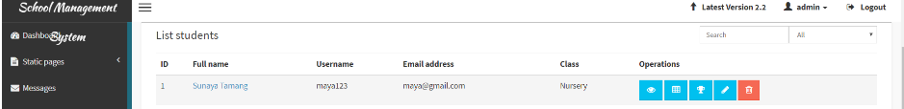
Now, we can see the modification data of the student
Figure 53: Student name being modified

Slide 36
Limitations
If the system crashes this application will be corrupted.
Backend can be accessed for the storage but there is limit in storage.
It is online software but not complete
This application can be used only by school management

Slide 37
conclusion
Finally, with the use of Laravel framework of the PHP and Xampp with database, I am able to complete the website for the school. The school is user friendly and good to use. Now, the school admin student teacher and parent can have easily access to the website and can get all the details of School. Most of the requirements of school is completed and some others parts I kept for future work.

Slide 38
References
https://www.workbreakdownstructure.com/
https://en.wikipedia.org/wiki/Configuration_management
https://www.tutorialspoint.com/mvc_framework/mvc_framework_introduction.htm/
https://laravel.com/
https://startbootstrap.com/

Slide 39
The end
Thank you

